Slide 1
Hyper-V Networking Best practice
Carsten Rachfahl

Slide 2
About Me
Carsten Rachfahl @hypervserver http://www.hyper-v-server.de
CTO of Rachfahl IT-Solutions GmbH & Co. KG
working in IT for 23 years (experience with computer for more than 30 years)
I‘m blogging, podcasting, video casting and tweeting about Microsoft Private Cloud
Microsoft MVP for Virtual Machine

Slide 3
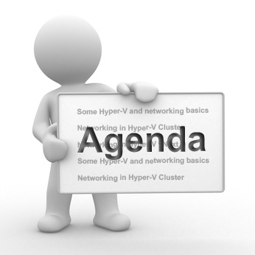
Agenda
Some Hyper-V and networking basics
Networking in Hyper-V Cluster
Networking in Hyper-V vNext
Notes:
Only a Developer VM maybee need not a Network

Slide 4
Why is Networking so important?
Nearly every VM need a network
Hyper-V Cluster is not really functional without a proper designed Network
I will speak about my „Hyper-V Networking Best Practices for Hyper-V R2 SP1”
Notes:
Only a Developer VM maybee need not a Network

Slide 5
Provided by:
Hyper-V Architecture
OS
ISV / IHV / OEM
Microsoft Hyper-V
Microsoft / (XenSource)
Parent Partition
Child Partitions
VM Worker Processes
Applications
Applications
Applications
Applications
User Mode
WMI Provider
VM Service
Linux Kernel
Windows Server
2008 /R2
Windows Server 2008 /R2
Windows mit Integrated Components
Non-Hypervisor Aware OS
VSP
Windows Kernel
Windows
Kernel
VSC
Windows Kernel
Linux VSC
KernelMode
IHV Drivers
IHV Drivers
VMBus
VMBus
Emulation
VMBus
Windows Hypervisor
“Designed for Windows” Server Hardware

Slide 6
Hyper-V Network Switch
Root Partition
Virtual Machine
„stupid“ Layer 2 Switch
three Network Types:
Private
Internal
External
Host NIC
VM NIC
Virtual Switch
Virtual Machine
Physical NIC
VM NIC
Physical Switch

Slide 7
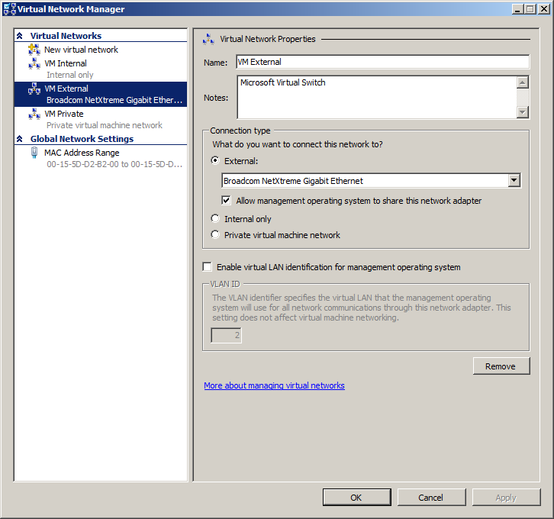
Hyper-V Networking Settings
DEMO

Slide 8
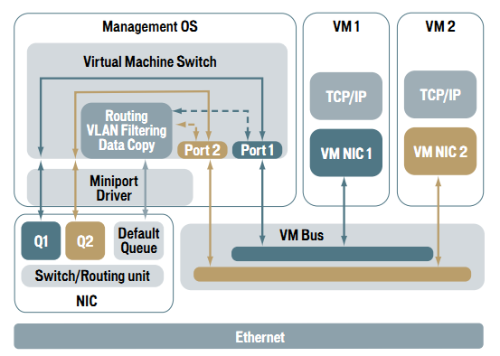
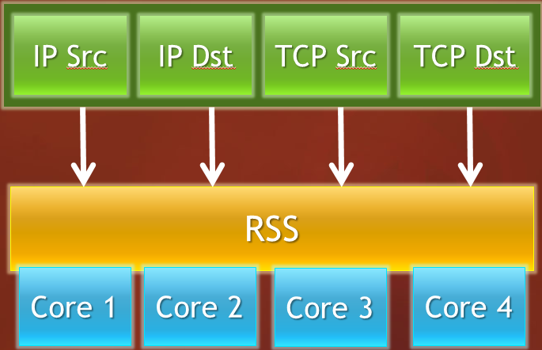
NIC Optimization
TCP Chimney Offload
Jumbo Frames (up to 9000 byte Packets)
Receive Side Scaling (RSS)
Virtual Machine Queuing (VMQ)
TCP Chimney NIC
Hardware TCP/IP Stack
ACK processing
TCP Reassembly
Zero copy on receive

Slide 9
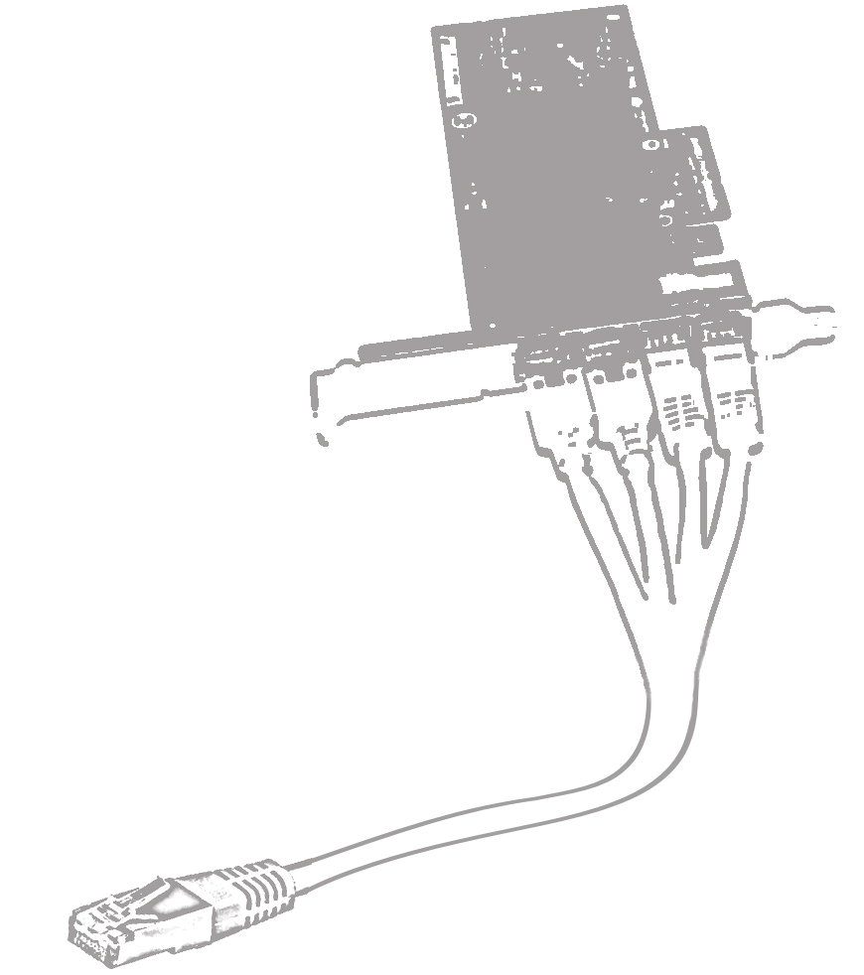
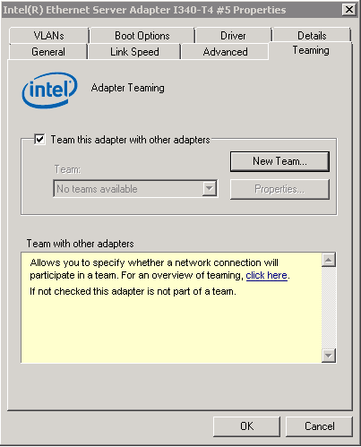
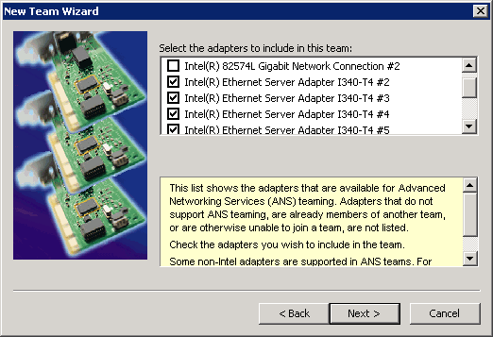
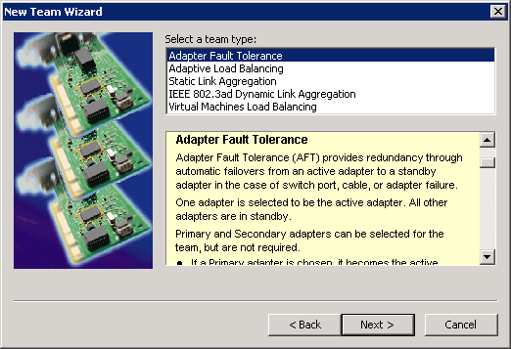
NIC Teaming
Feature to combine multiple network connections to one logical
no native Support in Window Server
NIC Vendors must provide Teaming capabilities
Active/Active or Active/Passive configuration
Some Teaming configurations need Switch support

Slide 10
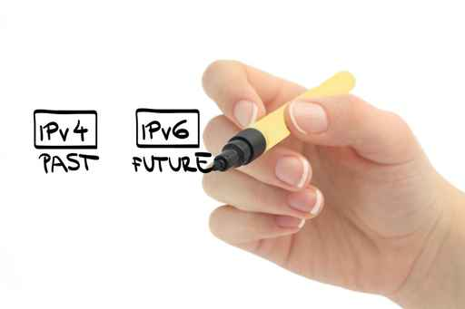
IPv4 and IPv6
IPv4 is fully supported
IPv6 is fully supported
Microsoft tests everything with IPv6 enabled
when you use IPv6 think about VLANs

Slide 11
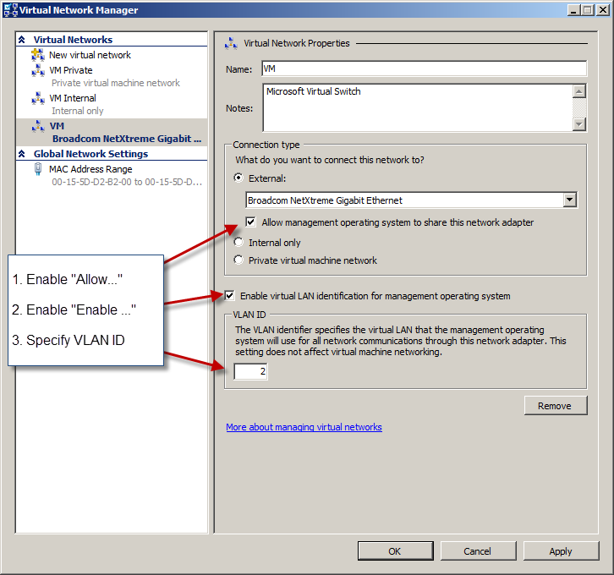
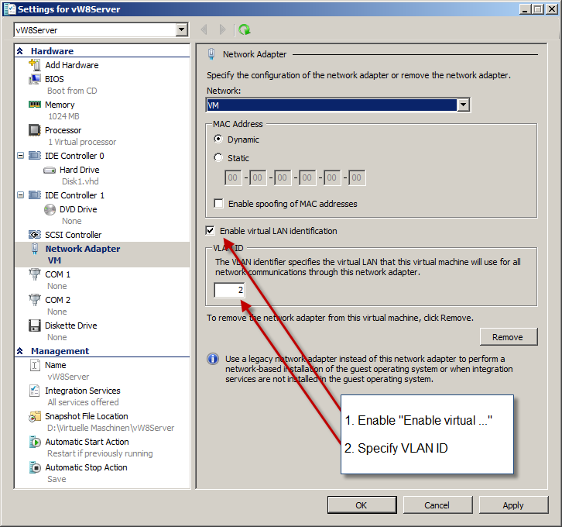
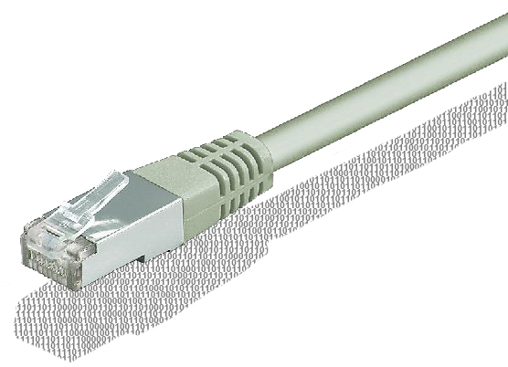
VLAN
VLAN (virtual LAN) segment traffic in a switched environment
VLAN Support for Parentpartition is set in the Hyper-V Switch
VLAN Support for VM is set on NIC

Slide 12
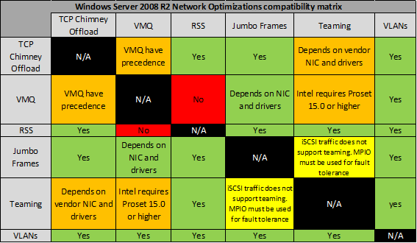
Features compatibility matrix
From Cristian Edwards Blog: http://blogs.technet.com/b/cedward/

Slide 13
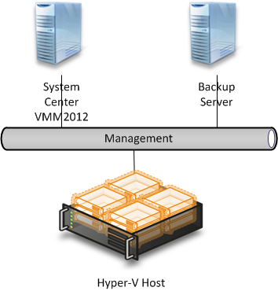
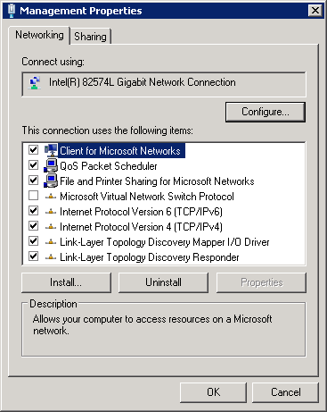
Management Network
Public Network w/gateway
Normaly used for:
Backup
System Center Agents
Patching
Anti Virus
Cluster Communication
Protocol Bindings

Slide 14
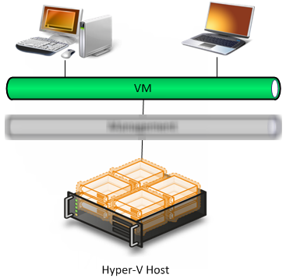
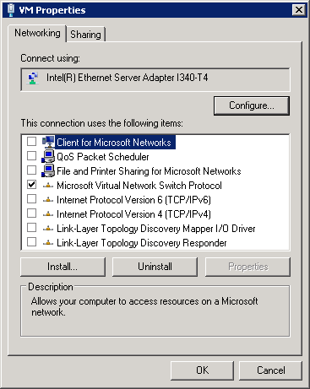
VM Network
Connect VM workload with the public network
Only for VM traffic
No Protocols bound except „Switch Protocol“

Slide 15
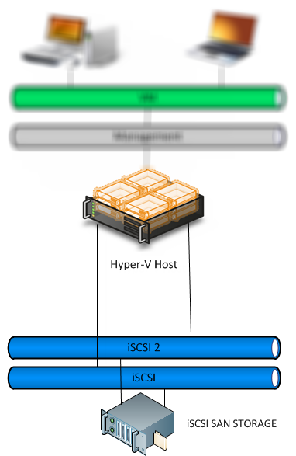
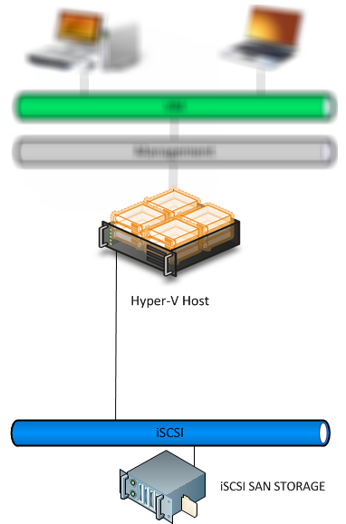
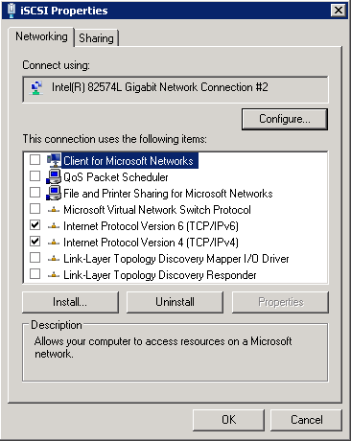
iSCSI Network(s)
private Network connect Host with iSCSI SAN Storage
Teaming is not supported
for Redundancy and Performance use MPIO
Bindings: only IP

Slide 16
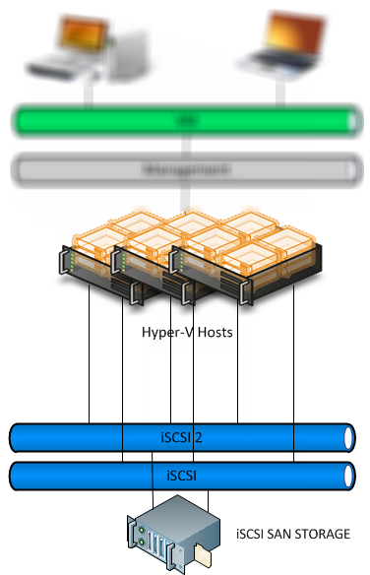
Hyper-V Cluster
Hyper-V Cluster delivers „High Availability“
15 Nodes with 1000 VMs
Failover in case of problems
Livemigration to move running VMs to another Host

Slide 17
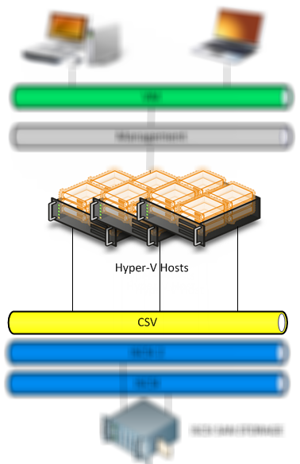
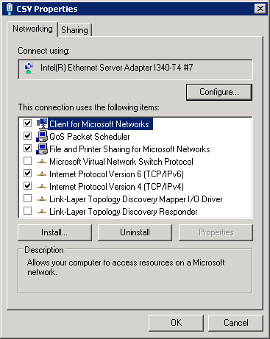
Heardbeat/CSV
Used for Cluster Communication
Used for redirected I/O
SMB Bindings needed

Slide 18
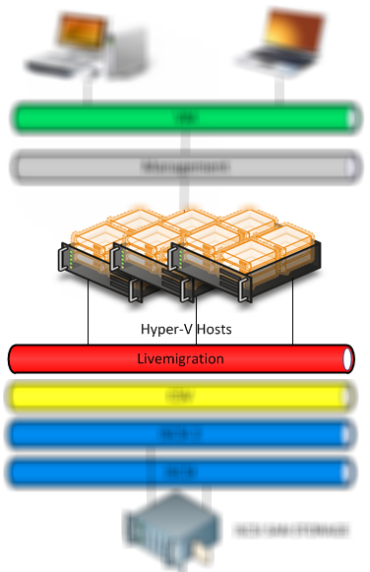
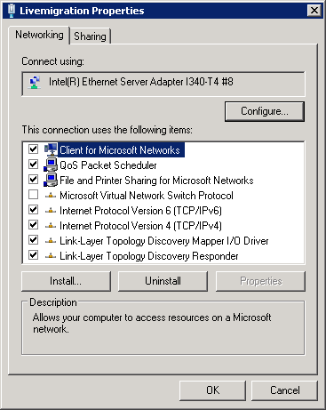
Livemigration
Livemigration moves a running VM to an other Host
Need a „big Pipe“
assume a VM with 4GB of Memory
over 1Gbit = 8s*4 = 32s over 10Gbit = 0,8s*4 = 3,2s
Bindings

Slide 19
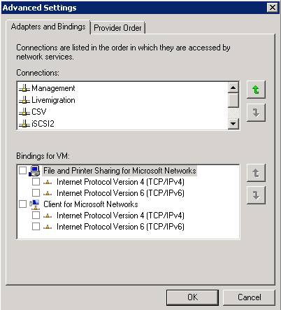
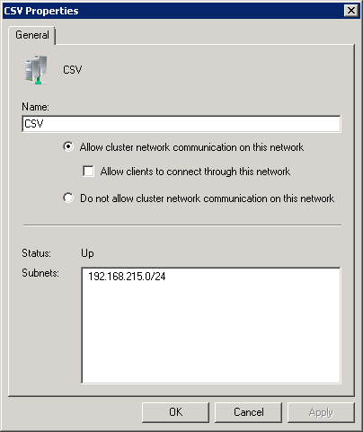
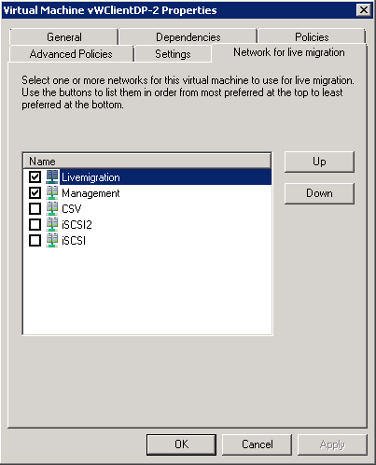
Cluster Network Setting
How does the Cluster know with Network to use for what purpose?
CSV:Network with lowest Metric
Heartbeat: on Cluster Network
Livemigration: Network on VM
Set the Network Order

Slide 20
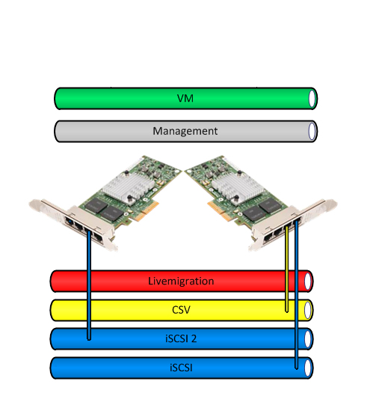
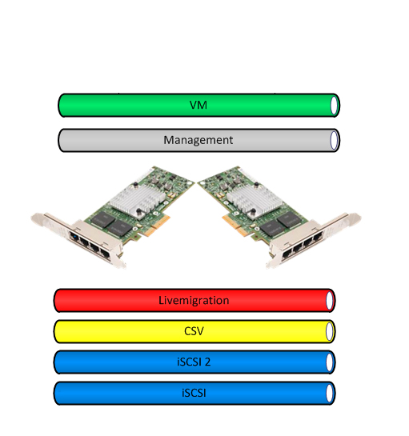
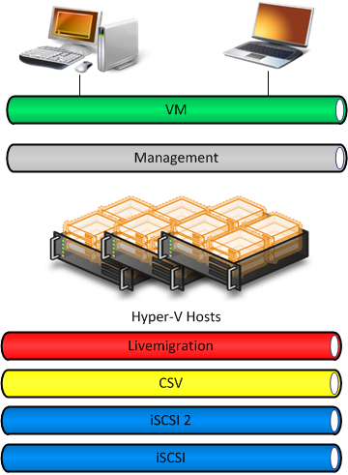
NIC balancing
Think about port distribution across different NICs
Best practice with 2 NICs:
iSCSI and iSCSI2 with MPIO pluged into different NICs
CSV Network
Livemigration use Teaming pluged into different NICs

Slide 21
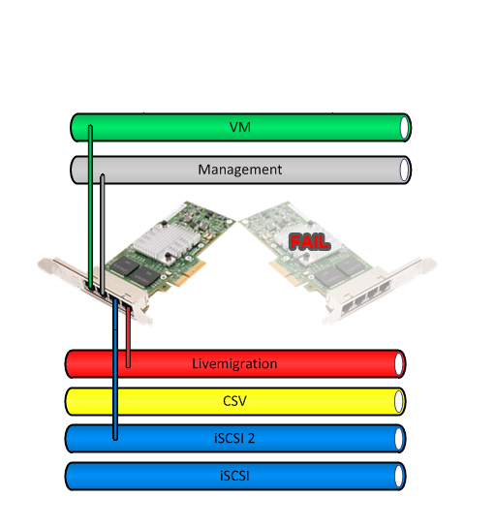
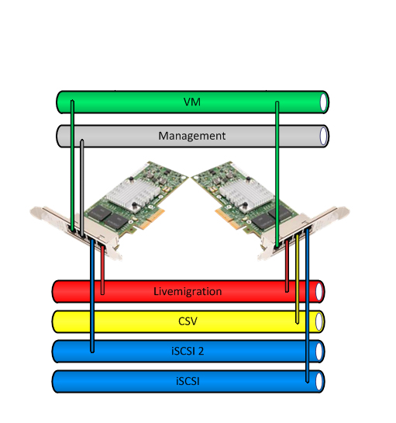
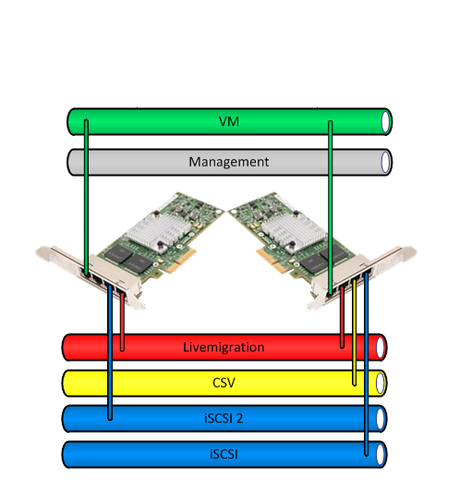
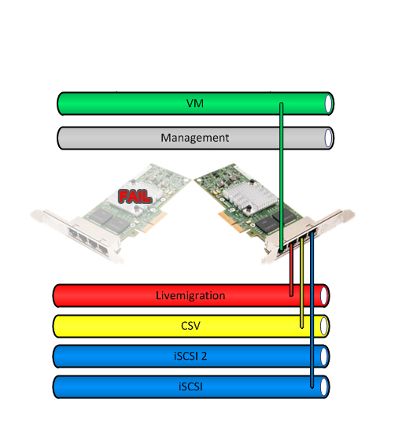
NIC balancing
VM Network use Teaming pluged into different NICs
Management Network
four Port NIC <> four NICs
What if?
right NIC fails
left NIC fails
FAIL

Slide 22
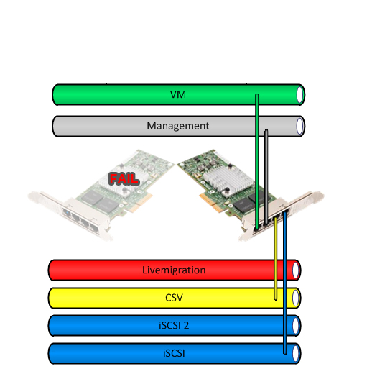
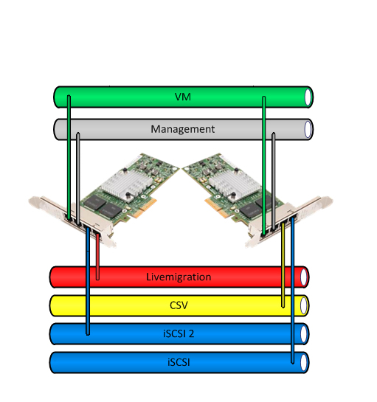
NIC balancing 2
New Best Practice!
Management use Teaming pluged in two NICs
What if?
right NIC fails
left NIC fails

Slide 23
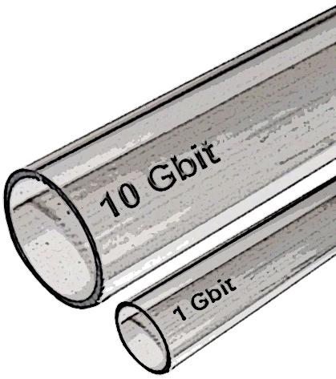
10GBit
Bigger “pipe” is always better
I prefer 10GB over NIC Teaming
Livemigration and VM Network will profit most
CPU usage! Use NIC Offload capabilities!

Slide 24
Hyper-V Cluster Networking
Demo

Slide 25
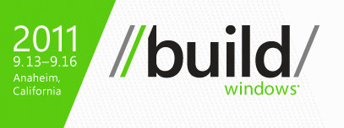
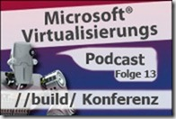
Hyper-V vNext
//build/ Conference www.buildwindows.com
On Microsoft Channel9 are 275 session videos
Podcast and Presentation about “Hyper-V in Windows 8”

Slide 26
Hyper-V vNext
native NIC Teaming support in „Windows 8“
SMB2.2 Multichannel and Direct (RDMA)
Single-Root I/O Virtualization (SR-IOV)
vFC for Guest Cluster
NIC Offloading:
Dynamic VMQ (D-VMQ)
Receive Segment Coalescing (RSC)
IPsec Offloading

Slide 27
Hyper-V extensible Switch
Many enhancements
Unified tracing / Port Mirroring
Network Virtualization
VM Mobility
PVLAN
Port ACLs + DHCP Guard
Minimum and Maximum Bandwidth
Extensible through 3rd party vendors
Cisco Nexus V1000 Switch
5nine vFireWall with Antivirus
inMon sflow Traffic Monitoring
NEC OpenFlow for Hyper-V
Broadcom Hyper-V Switch Extension
Virtual Machine
Virtual Machine
Root Partition
VM NIC
Host NIC
VM NIC
Virtual Switch
Extension Protocol
Ingress Traffic
Egress Traffic
Extension
Capture Extensions
WFP Extensions
Extension
Filtering Extensions
Extension
Forwarding Extension
Extension
Extension Miniport
Physical NIC

Slide 28
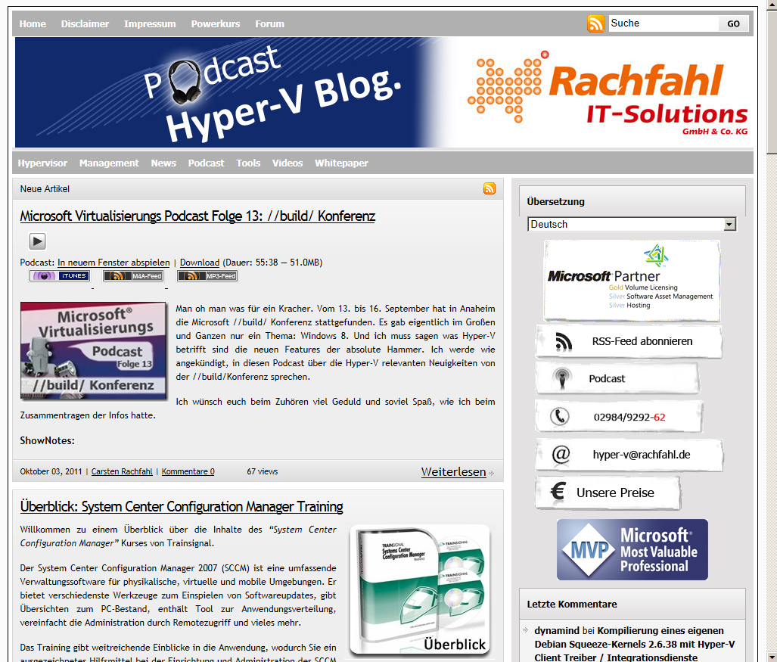
Where to learn more?
On our blog you will find an post with more information's about this talk
http://www.hyper-v-server.de/TECconf

Slide 29
Questions?

